Slide 1
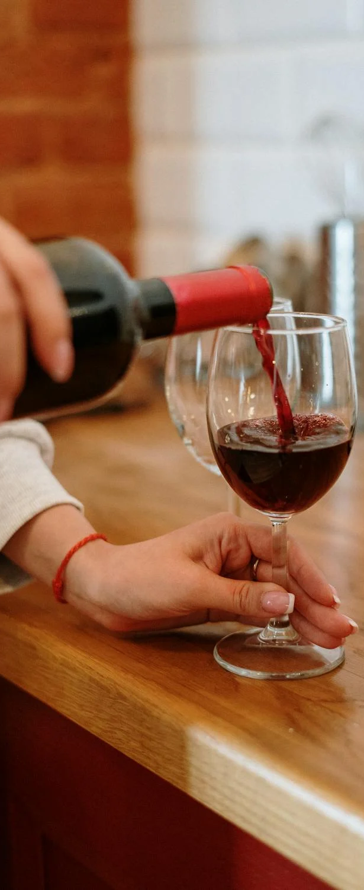

On Cloud Wine
Sip back and relax
Team Cushion
Tim Barney, Dylan Davis, Ange Ndjeka, OLUWASEUN OREPEKAN, Nolan Simmons

Slide 2
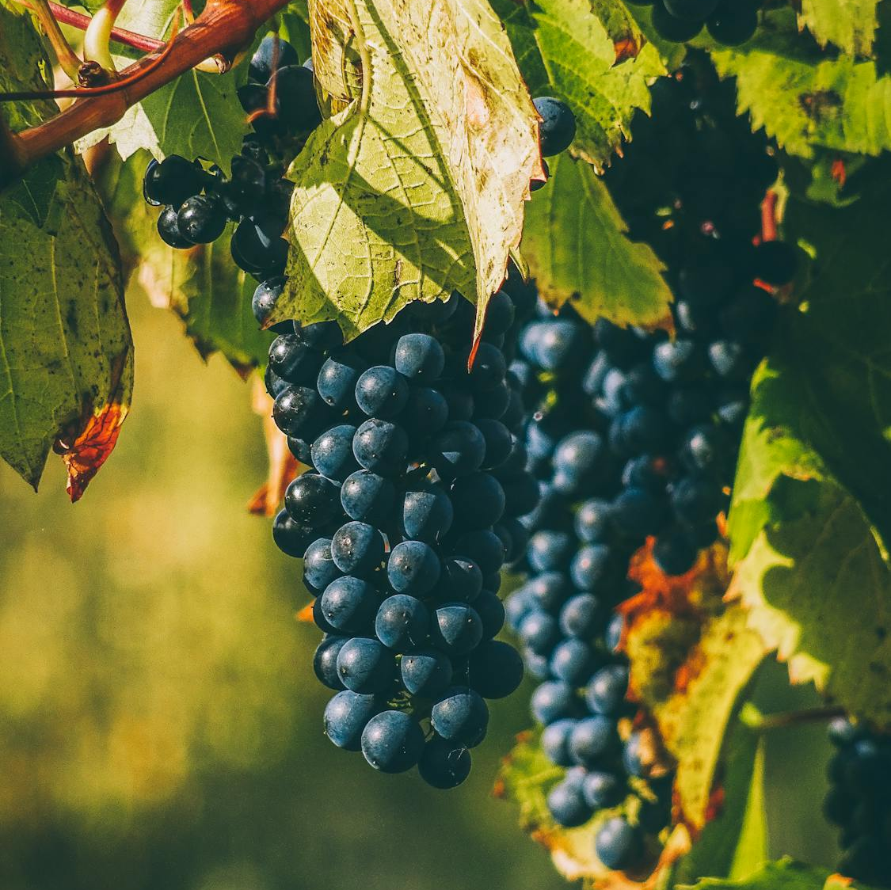
Introduction to the data
This is a dataset from Kaggle, originating from the University of California in Irine.
It was designed for machine learning.
https://www.kaggle.com/datasets/uciml/red-wine-quality-cortez-et-al-2009

Slide 3
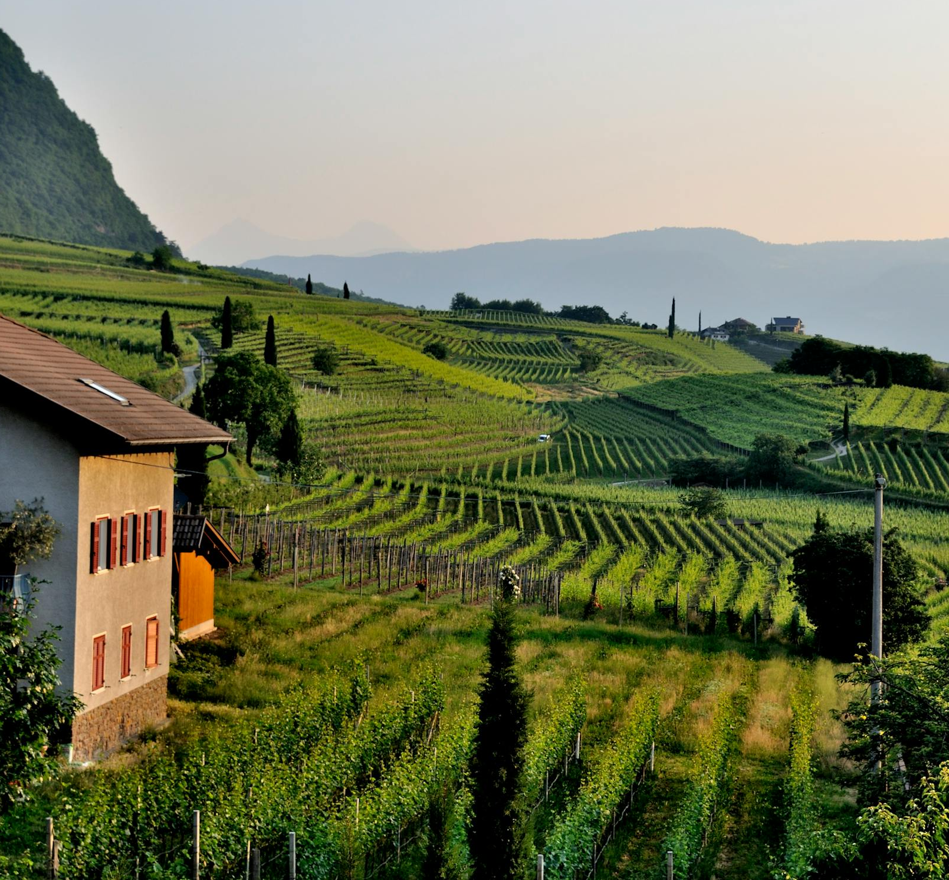



ETL Process
We imported the data into a Data Frame using the Kaggle API, verified no nulls, and the data types where correct, then used SQL Alchemy to create a table and import the data onto that table on our Neon server.

Slide 4
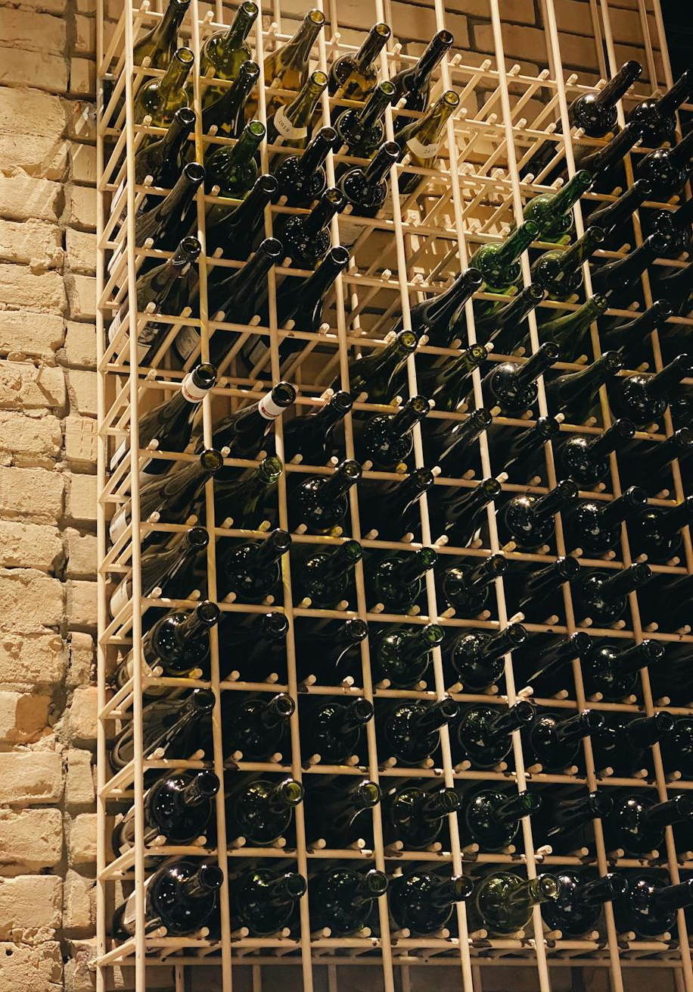
Overview of the Analysis
Goal of the Analysis is to accurately predict whether the wine is of good quality or not.
We ended up simplifying the ratings IE anything over 6 is good quality, below is bad quality

Slide 5
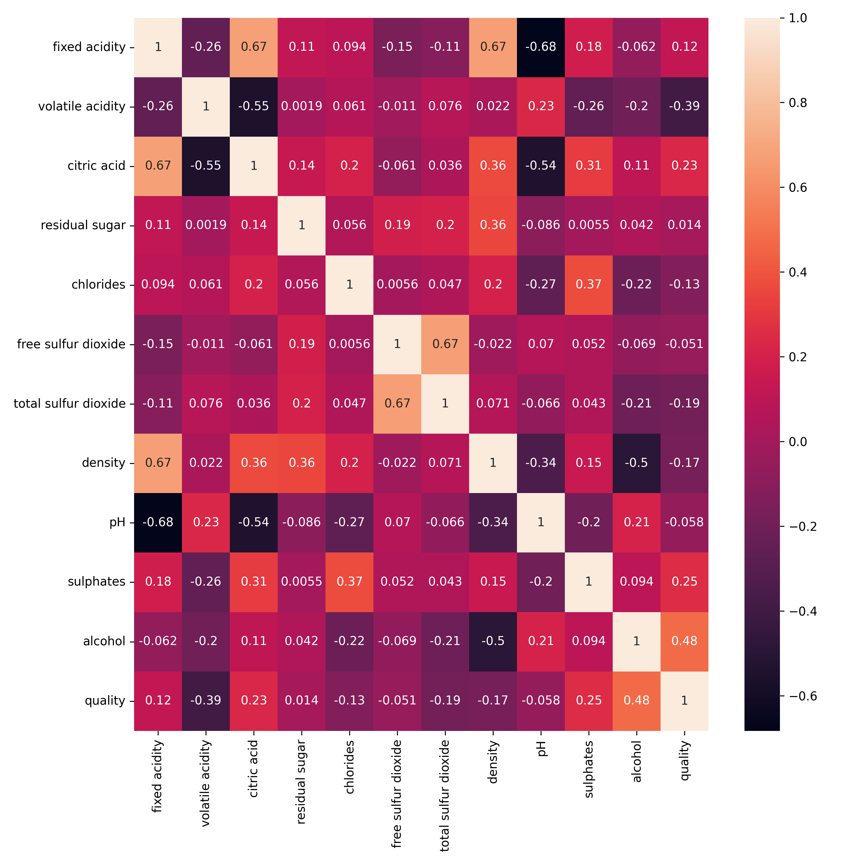
Correlation Matrix

Slide 6
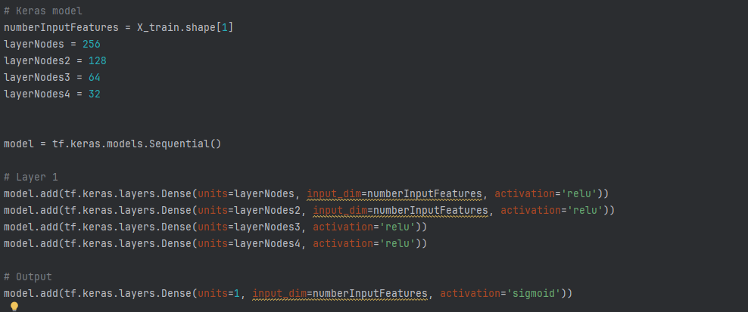
Overview of analysis continued
We trained a basic deep learning model to predict the results and made a few graphs to show the resulting accuracy of the model.
We used Tensor Flow and the Keras sequential model using five layers

Slide 7
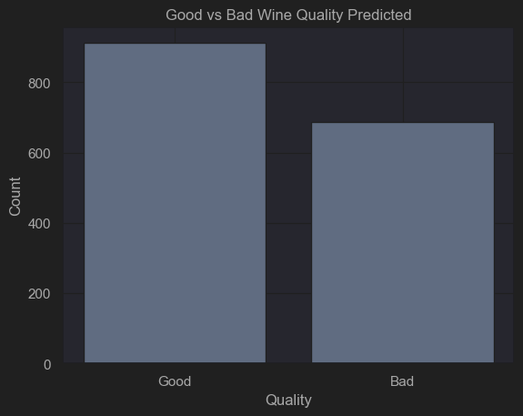
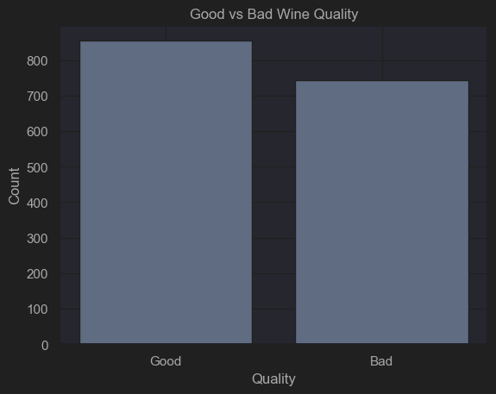
Good vs Bad wine predicted vs True

Slide 8
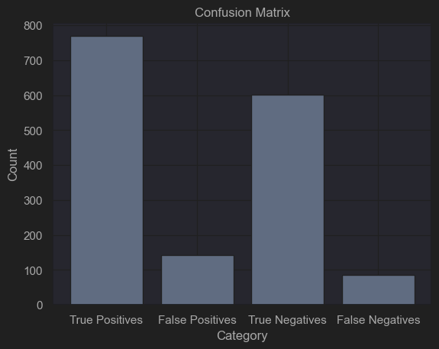
Cool confusion matrix (true vs false negatives/positives)

Slide 9
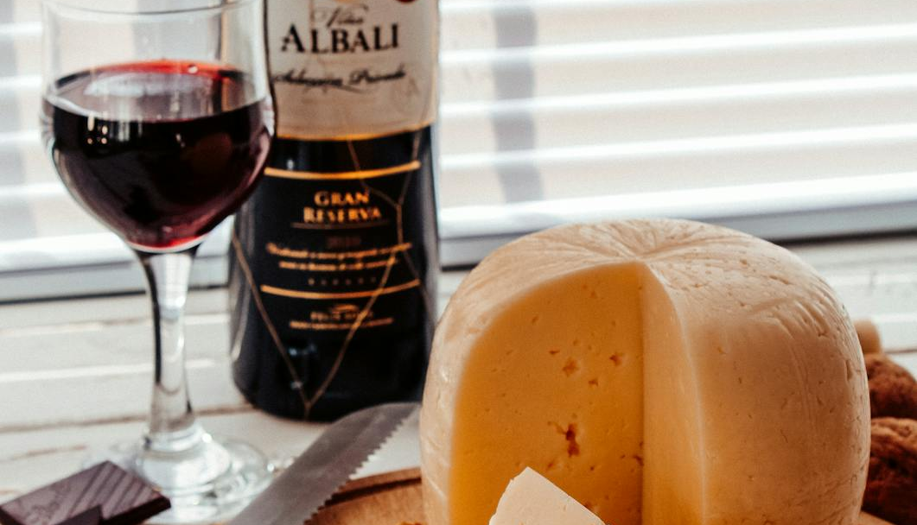
The end

